Slide 1

CS688: Web-Scale Image Retrieval
Inverted Index
Sung-Eui Yoon
(윤성의)
Course URL:
http://sgvr.kaist.ac.kr/~sungeui/IR
Notes:
1

Slide 2
Class Objectives
Discuss re-ranking for achieving higher accuracy
  Spatial verification
  Query expansion
Understand approximate nearest neighbor search
  Inverted index and inverted multi-index
At the last class:
  Bag-of-visual-Words (BoW) models
  CNN w/ triplet loss (ranking loss)

Slide 3
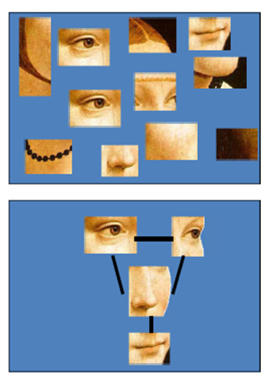
Problems of BoW Model
No spatial relationship between words
How can we perform segmentation and localization?
Ack.: Fei-Fei Li

Slide 4
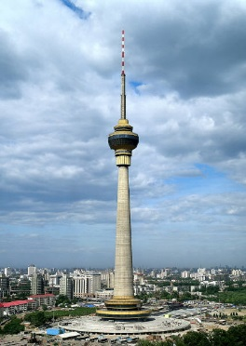

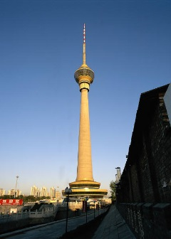
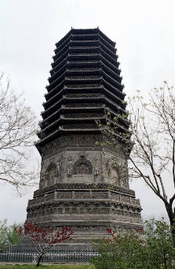
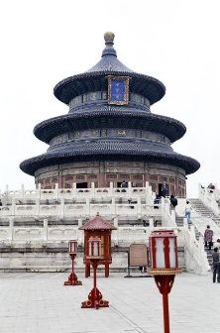
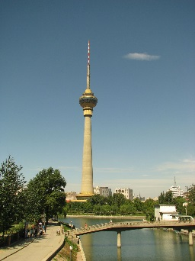
Post-Processing or Reranking
Query image
Shortlist (e.g., 100 images)
Database
..
Re-ranking
..
Notes:
To achieve this goal, our technique is based on image retrieval
Image retrieval is an image search system using image as a query not on text. [click]
For example, when we have lots of image [click]
We extract image features and store them in the databases. [click]
When the query image is enter, [click] we can find similar images and output them
With this process, we can detect similar images in very short time.

Slide 5
Post-Processing
Geometric verification
  RANSAC
Query expansion
Matching w/o spatial matching
(Ack: Edward Johns et al.)
query
input
DB
results

Slide 6
Geometric Verification using RANSAC
Repeat N times:
e
z
e
- Randomly choose 4 matching pairs
z
a
a
f
f
e
e
Estimate transformation
  Assume a particular transformation (Homography)
Transform
- Predict remaining points and count “inliers”
e
z
e
z
a
a
f
f
e
e
Ack.: Derek Hoiem (UIUC)

Slide 7
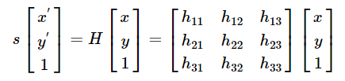
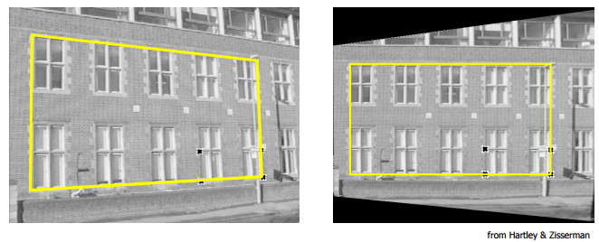
Homography
Transformation, H, between two planes
  8 DoF due to normalization to 1

Slide 8

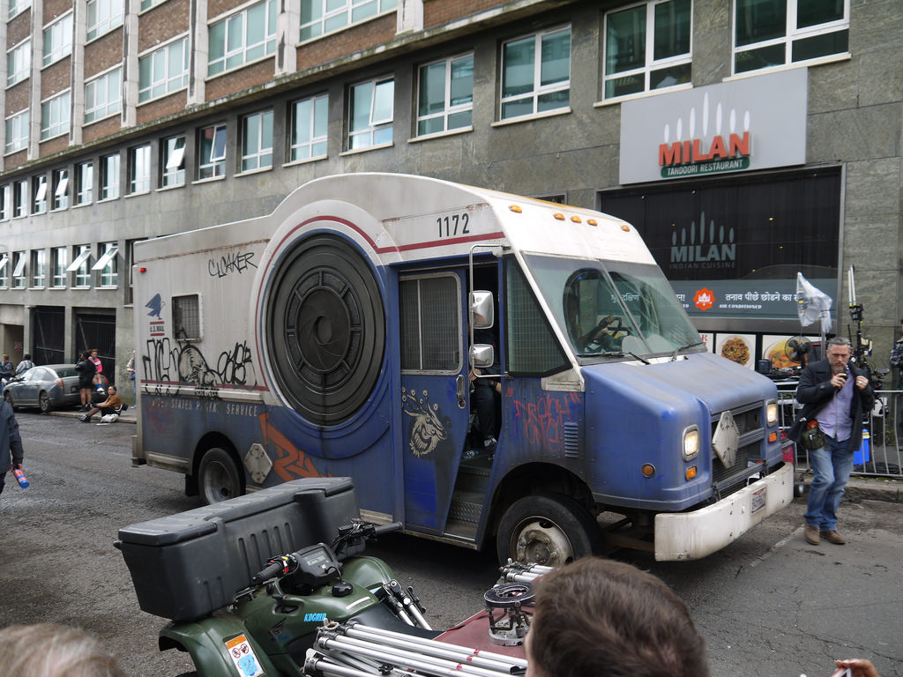
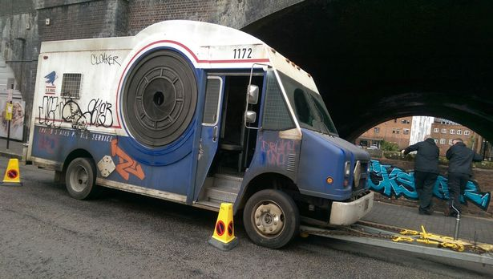
Pattern matching
Drones surveying city
  Identify a particular car

Slide 9
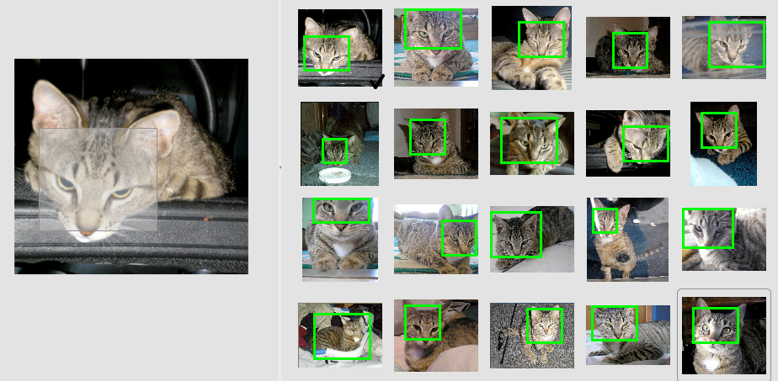
Image Retrieval with Spatially Constrained Similarity Measure
[Xiaohui Shen, Zhe Lin, Jon Brandt, Shai Avidan and Ying Wu, CVPR 2012]

Slide 10
Learning to Find Good Correspondences, CVPR 18
Given two sets of input features (e.g., SIFTs), return a prob. of being inliers for each feature
  Adopt the classification approach being inlier or not
  Consider the relative motion between two images for the loss function

Slide 11
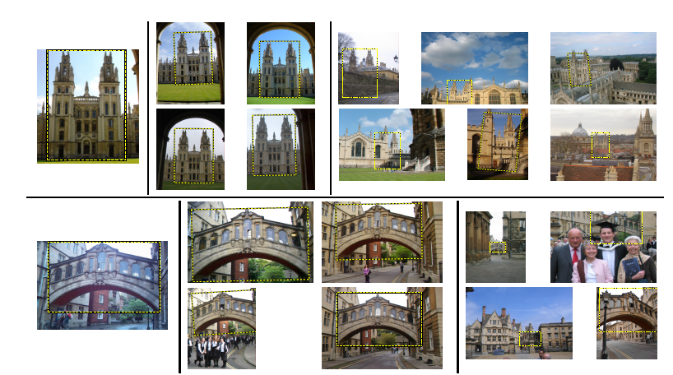
Query Expansion [Chum et al. 07]
Expanded results that were not identified by the original query
Original query
Top 4 images

Slide 12
Efficient Diffusion on Region Manifolds, CVPR 17 & 18
Identify related images by the diffusion process, i.e., random walks
  Perform random walks based on the similarity between a pair of images
Utilize k-Nearest
Neighbor (NNs) of the
query images

Slide 13
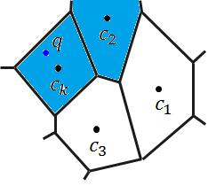







Inverted File or Index for Efficient Search
For each word, list images containing the word
feature space
Inverted File
Near cluster
search
…
Shortlist
Re-ranking
Ack.: Dr. Heo

Slide 14
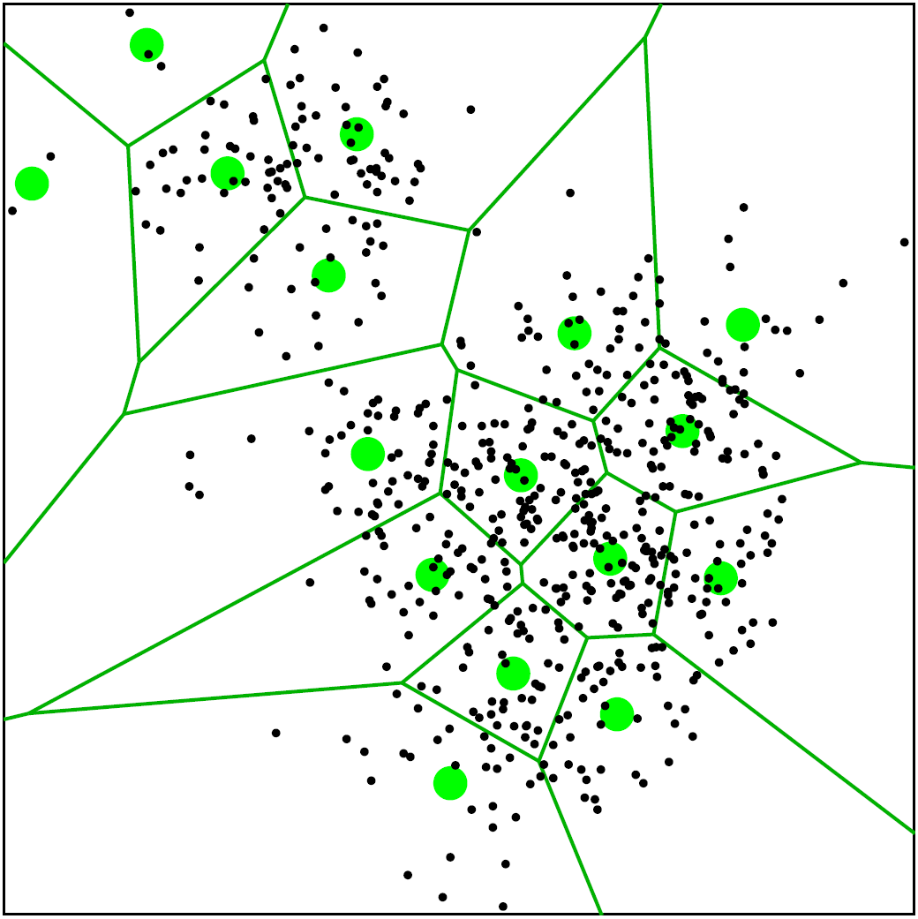
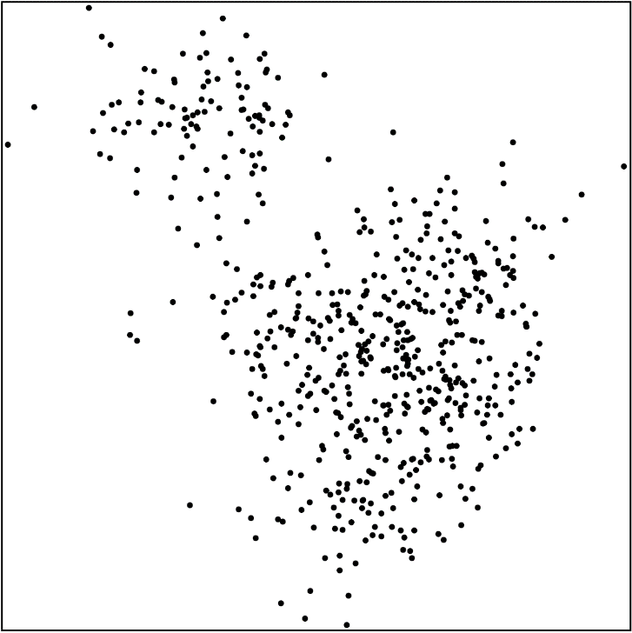






Inverted Index
Construction time:
Generate a codebook by quantization
  e.g. k-means clustering
Build an inverted index
  Quantize each descriptor into the closest word
  Organize desc. IDs in terms of words
Figure from Lempitsky’s slides
$${word}_{1}$$
$$id$$ | $$id$$ | $$id$$ | … | $$id$$
$${word}_{2}$$
$$id$$ | $$id$$ | $$id$$
…
inverted index
$${word}_{k}$$
$$id$$ | $$id$$
Ack.: Zhe Lin
Notes:
Large vocabulary: (1) Small quantization error, (2) expensive to find kNN words

Slide 15
Inverted Index
Query time:
Given a query,
  Find its K closest words
  Retrieve all the data in the K lists corresponding to the words
Large K
  Low quantization distortion
  Expensive to find kNN words
Ack.: Zhe Lin
Notes:
Large vocabulary: (1) Small quantization error, (2) expensive to find kNN words

Slide 16
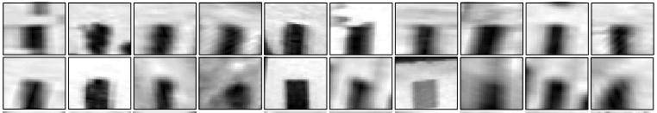

The inverted index
"Visual word"
Sivic & Zisserman ICCV 2003
Visual codebook
Notes:
In the end, the problem is that we are too mean (just one integer per descriptor)

Slide 17
Approximate Nearest Neighbor (ANN) Search
For large K
  Takes time to find clusters given the query
  Use those ANN techniques for efficiently finding near clusters
ANN search techniques
  kd-trees: hierarchical approaches for low-dimensional problems
  Hashing for high dimensional problems; will be discussed later with binary code embedding
  Quantization (k-means cluster and product quantization)

Slide 18
kd-tree Example
Many good implementations (e.g., vl-feat)

Slide 19
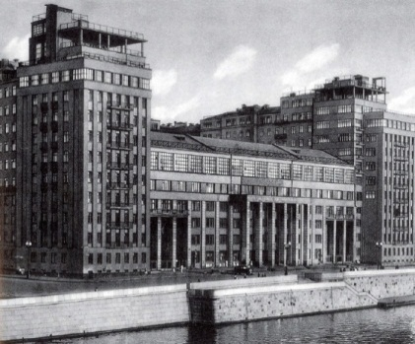
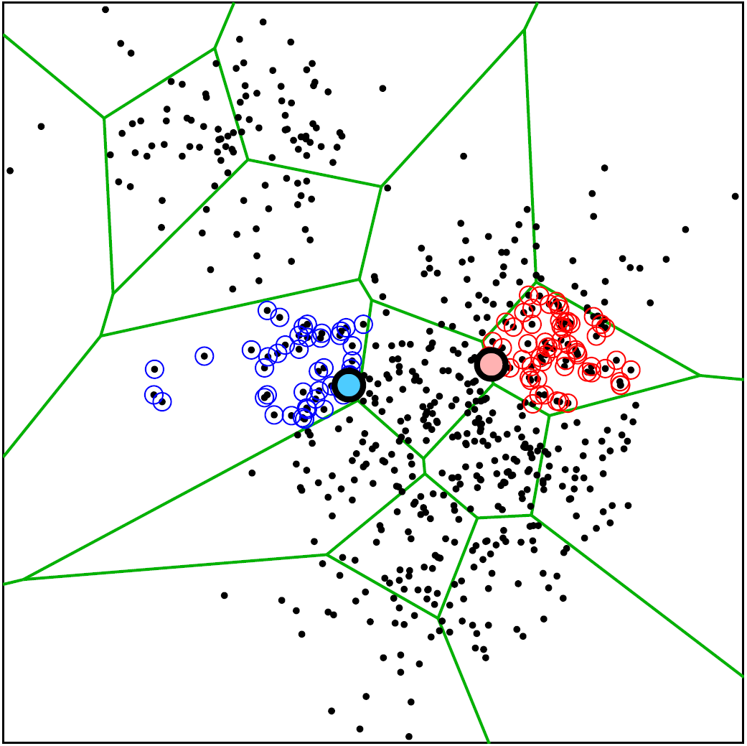
Querying the inverted index
Query:
Have to consider several words for best accuracy
Want to use as big codebook as possible
Want to spend as little time as possible for matching to codebooks
conflict
Ack.: Lempitsky
Notes:
In the end, the problem is that we are too mean (just one integer per descriptor)

Slide 20
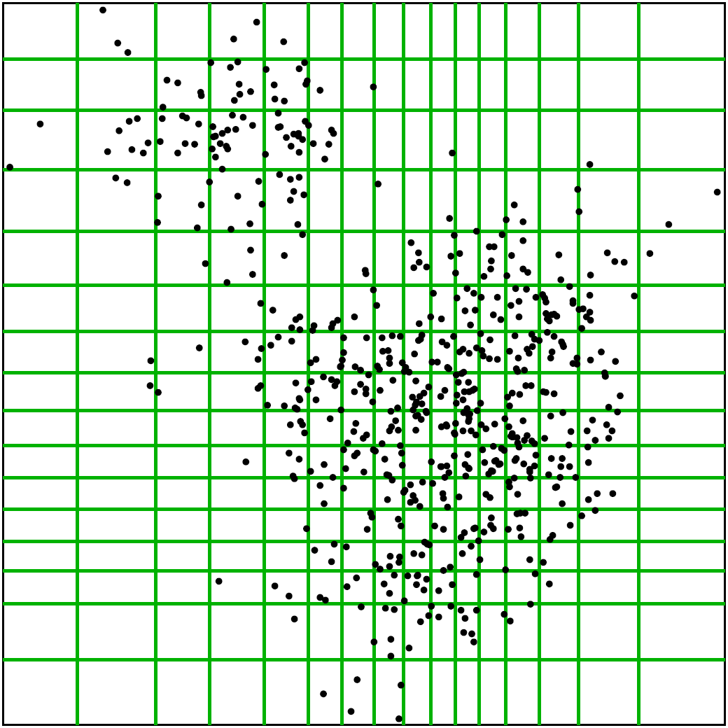
Inverted Multi-Index
[Babenko and Lempitsky, CVPR 2012]
Product quantization for indexing
Main advantage:
  For the same K, much finer subdivision
  Very efficient in finding kNN codewords
Ack.: Lempitsky

Slide 21
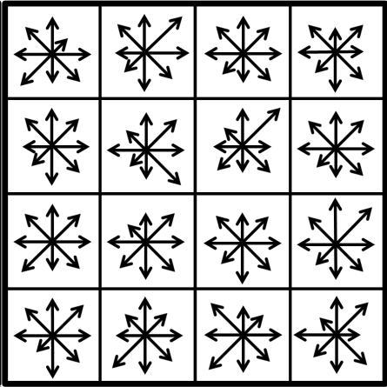
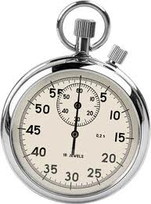
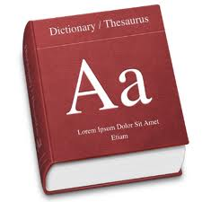
Product quantization
Split vector into correlated subvectors
use separate small codebook for each chunk
Quantization vs. Product quantization:
For a budget of 4 bytes per descriptor:
Use a single codebook with 1 billion codewords or many minutes 128GB
Use 4 different codebooks with 256 codewords each < 1 millisecond 32KB
Ack.: Lempitsky

Slide 22
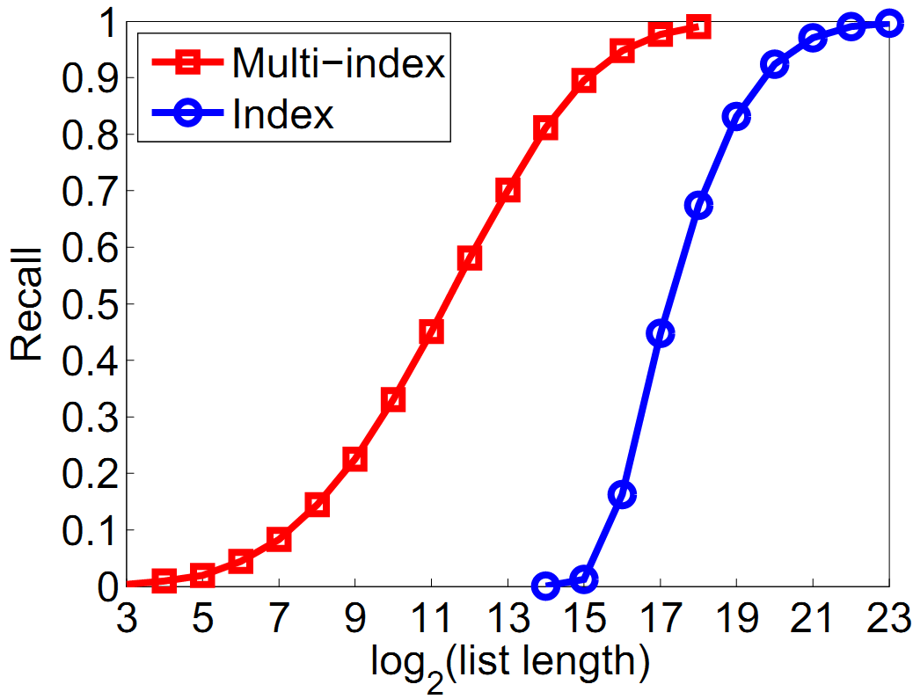
Performance comparison on 1 B SIFT descriptors
100x
K = 2¹⁴
Time increase: 1.4 msec -> 2.2 msec on a single core
(with BLAS instructions)
Ack.: Lempitsky

Slide 23
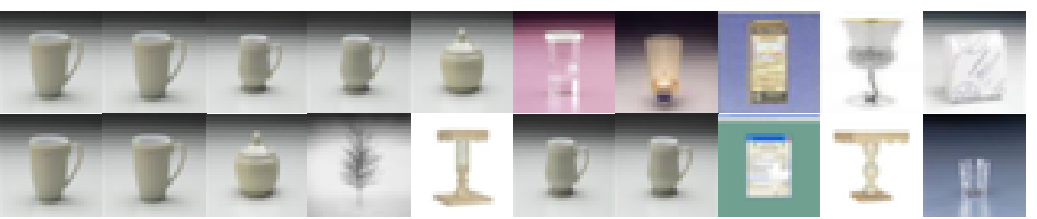
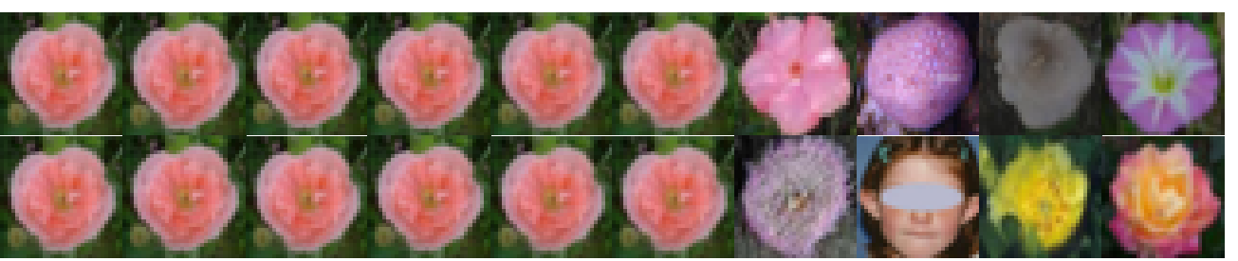
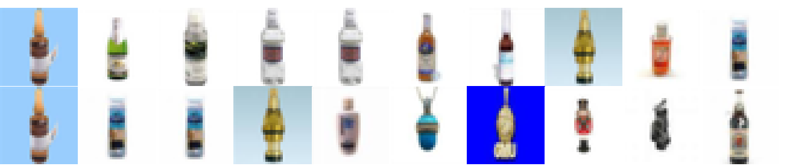
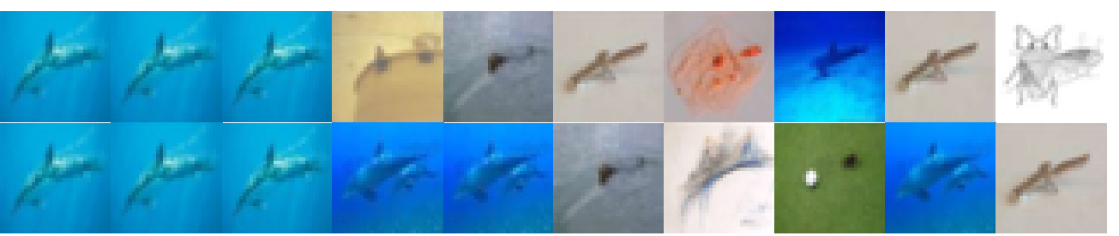
Retrieval examples
Exact NN
Uncompressed GIST
Multi-D-ADC
16 bytes
Exact NN
Uncompressed GIST
Multi-D-ADC
16 bytes
Exact NN
Uncompressed GIST
Multi-D-ADC
16 bytes
Exact NN
Uncompressed GIST
Multi-D-ADC
16 bytes
Ack.: Lempitsky

Slide 24
Scalability
Issues with billions of images?
  Searching speed → inverted index
  Accuracy → larger codebooks, spatial verification, expansion, features
  Memory → compact representations
  Easy to use?
  Applications?
  A new aspect?

Slide 25
Class Objectives were:
Discuss re-ranking for achieving higher accuracy
  Spatial verification
  Query expansion
Understand approximate nearest neighbor search
  Inverted index
  Inverted multi-index

Slide 26
Next Time…
Hashing techniques

Slide 27
Homework for Every Class
Go over the next lecture slides
Come up with one question on what we have discussed today
  1 for typical questions (that were answered in the class)
  2 for questions with thoughts or that surprised me
Write questions 3 times

Slide 28
Figs

Slide 29






Inverted Index
Inverted index
$${cluster}_{1}$$
$$id$$ | $$id$$ | $$id$$ | … | $$id$$
$${cluster}_{2}$$
$$id$$ | $$id$$ | $$id$$
…
$${cluster}_{k}$$
$$id$$ | $$id$$
Ack.: Zhe Lin
Notes:
Large vocabulary: (1) Small quantization error, (2) expensive to find kNN words

